Slide 1


Analyzing Employee Attrition Using Machine Learning Techniques
Presented by: Haris Fayyaz

Slide 2
Why I choose this Project?
Coming from an Accounting & Finance , was always passionate about business and its insights
Want to build my startup in the near future
However one of the main issue in a business is its employees attrition of whether the employees tend to stay in a company or not.
Wanted to determine the factors that determine employee attrition
Help me end up being a better employer

Slide 3
Industry Significance?
Employee attrition affects organizations across industries, regardless of size or sector.
High turnover rates can lead to decreased productivity and loss of institutional knowledge (experience ,important data, etc).
High attrition rates can disrupt workflow, decrease morale, and affect overall performance
Understanding the factors contributing to attrition can help organizations proactively address issues and implement effective retention strategies.
Predicting employee attrition is crucial for organizations to mitigate turnover costs and implement effective retention strategies.

Slide 4
Data Columns :
Attrition
Age
Business Travel
Daily Rate
Department
Distance From Home
Education
Education Field
Employee Count
Employee Number
Environment Satisfaction
Gender
Hourly Rate
Job Involvement
Job Level
Job Role
Job Satisfaction
Marital Status
Monthly Income
Monthly Rate
Num Companies Worked
Over 18
Over Time
Percent Salary Hike
Performance Rating
Relationship Satisfaction
Standard Hours
Stock Option Level
Total Working Years
Training Times Last Year
Work Life Balance
Years At Company
Years In Current Role
Years Since Last Promotion
Years With Curr Manager

Slide 5
Exploratory Data Analysis

Slide 6
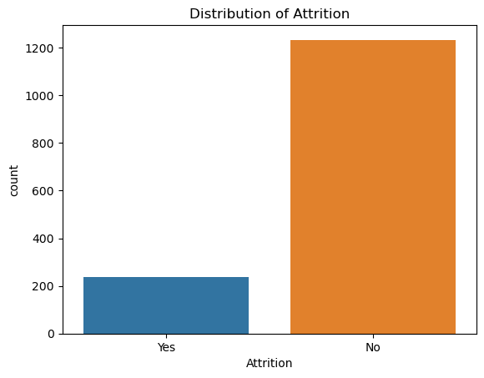
Distribution of Attrition
Yes | 237
No | 1233

Slide 7
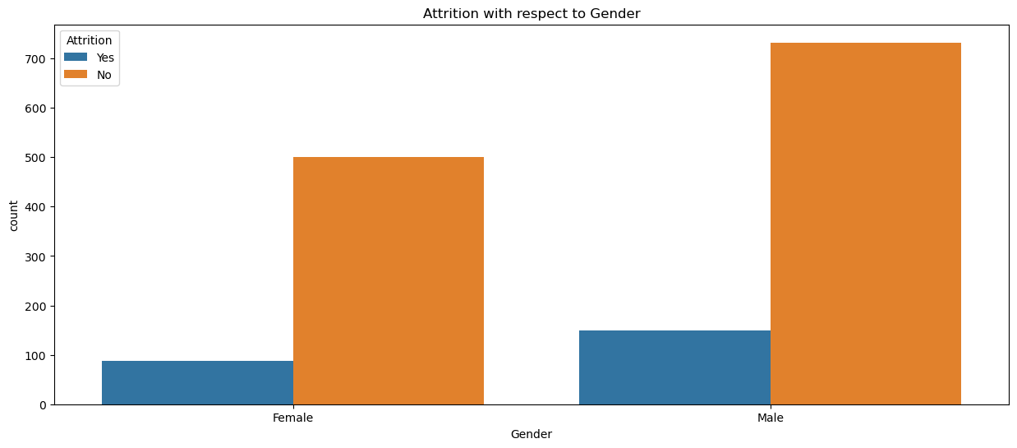
Distribution of Gender
 | Male | Female
Attrition (%) | 17% | 14.7%
 | Yes | No
Male | 150 | 732
Female | 87 | 501

Slide 8
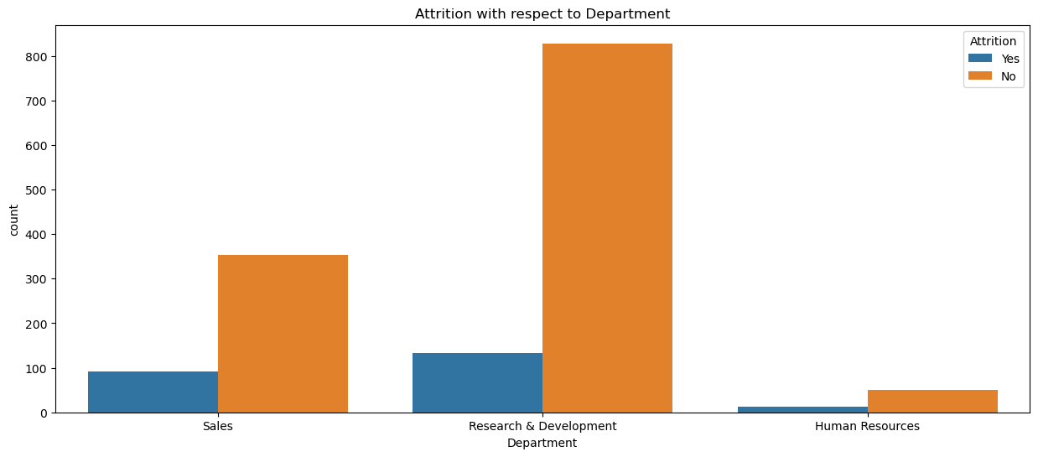
Attrition w.r.t Department
 | Yes | No
Sales | 92 | 354
R&D | 133 | 828
HR | 12 | 51

Slide 9
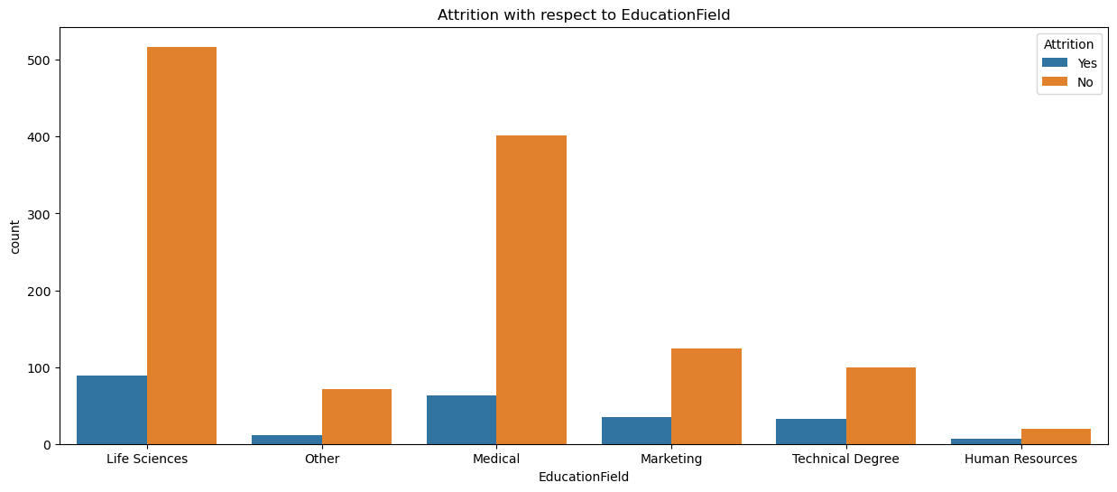
Attrition w.r.t Education Field

Slide 10
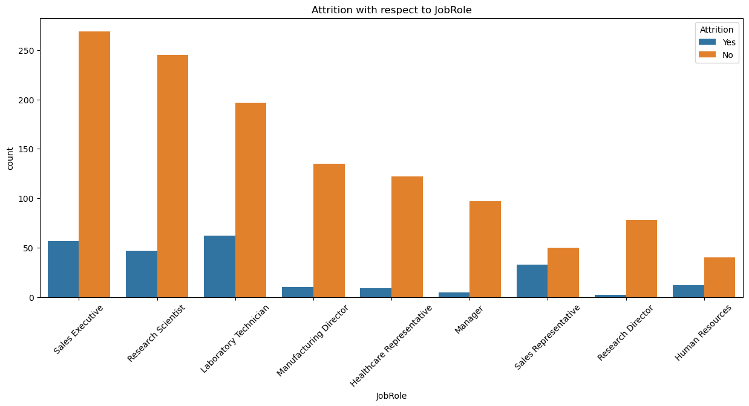
Attrition w.r.t Job Role

Slide 11
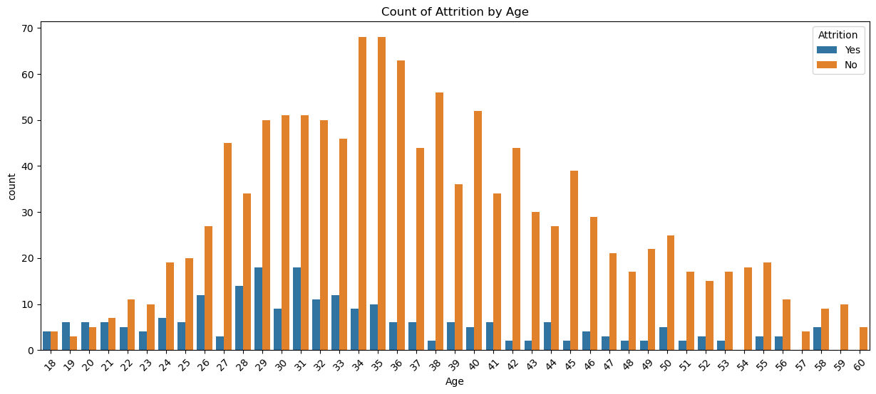
Count of Attrition by Age

Slide 12
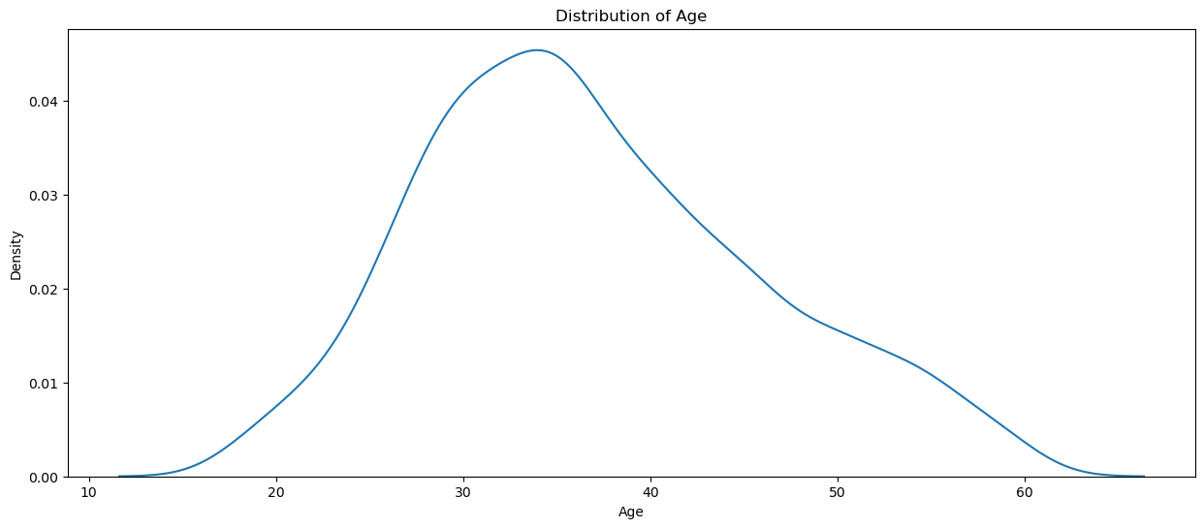
Distribution of Age
The highest density is around the age of 25-30, indicating that there is a relatively larger concentration of individuals in this age group within the employee age population.

Slide 13
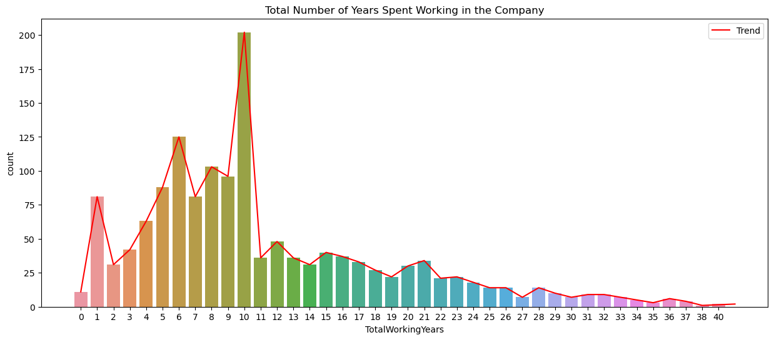
Total No of Years Spent

Slide 14
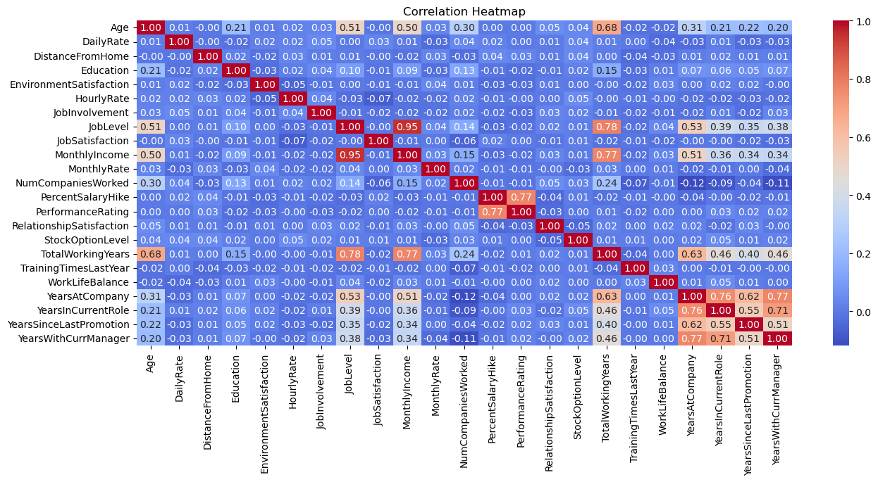
Correlation Heatmap
Strongest correlation between job level and monthly income.
Higher job level more is the monthly income.
Least correlation between number of years worked and environment satisfaction.
Higher number of working years does not guarantee more environment satisfaction.

Slide 15
Machine Learning Approaches:
Splitting (70% Training & 30% Testing)

Slide 16
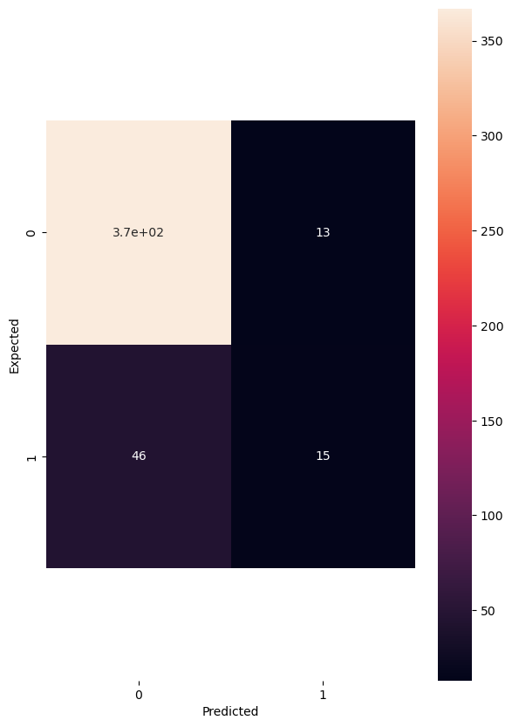
Logistic Regression
1) True Positive (TP): The model correctly predicted that 367 employees would leave the company.
2) False Positive (FP): The model incorrectly predicted that 13 employees would leave the company when they actually didn't.
3) False Negative (FN): The model incorrectly predicted that 46 employees would not leave the company when they actually did.
4) True Negative (TN): The model correctly predicted that 15 employees would not leave the company.

Slide 17
Model Comparison
 | Model | Score (%)
1) | Logistic Regression | 86.16%
2) | Random Forest | 86.84%
3) | Support Vector Machine (SVM) | 86.84%
Logistic Regression model achieved slightly lower accuracy as compared to the Random Forest and SVM Model

Slide 18









BORCELLE
THANK'S FOR WATCHING

